Slide 1
Emotional Regulation & Hypnosis
Dr Michelle Mackin
Counselling Psychologist

Slide 2
What is Emotional Regulation
Emotional regulation is like a homeostatic thermostat – it can moderate emotions and keep them in a manageable range so that the person can cope.
Leahy et al. (2011)

Slide 3
Emotional Dysregulation
Emotional intensification (hyperarousal)
Emotion becomes overwhelming or intrusive.
panic
Intense fear
traumatic re-experiencing
urgency / threat responses
Siegel (2012)

Slide 4
Emotional Dysregulation
Emotional deactivation (hypoarousal)
Emotion becomes shut down or disconnected.
dissociation
depersonalisation
emotional numbing
disengagement
Siegel (2012)

Slide 5
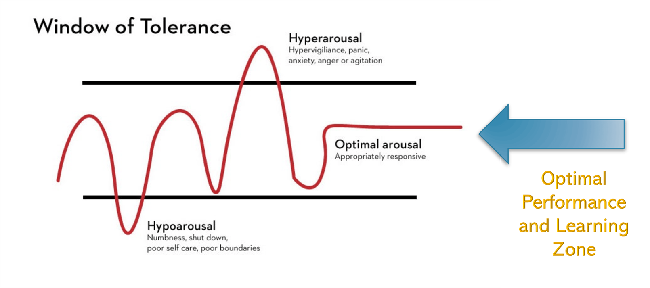
Window of Tolerance
Siegel (2012)

Slide 6
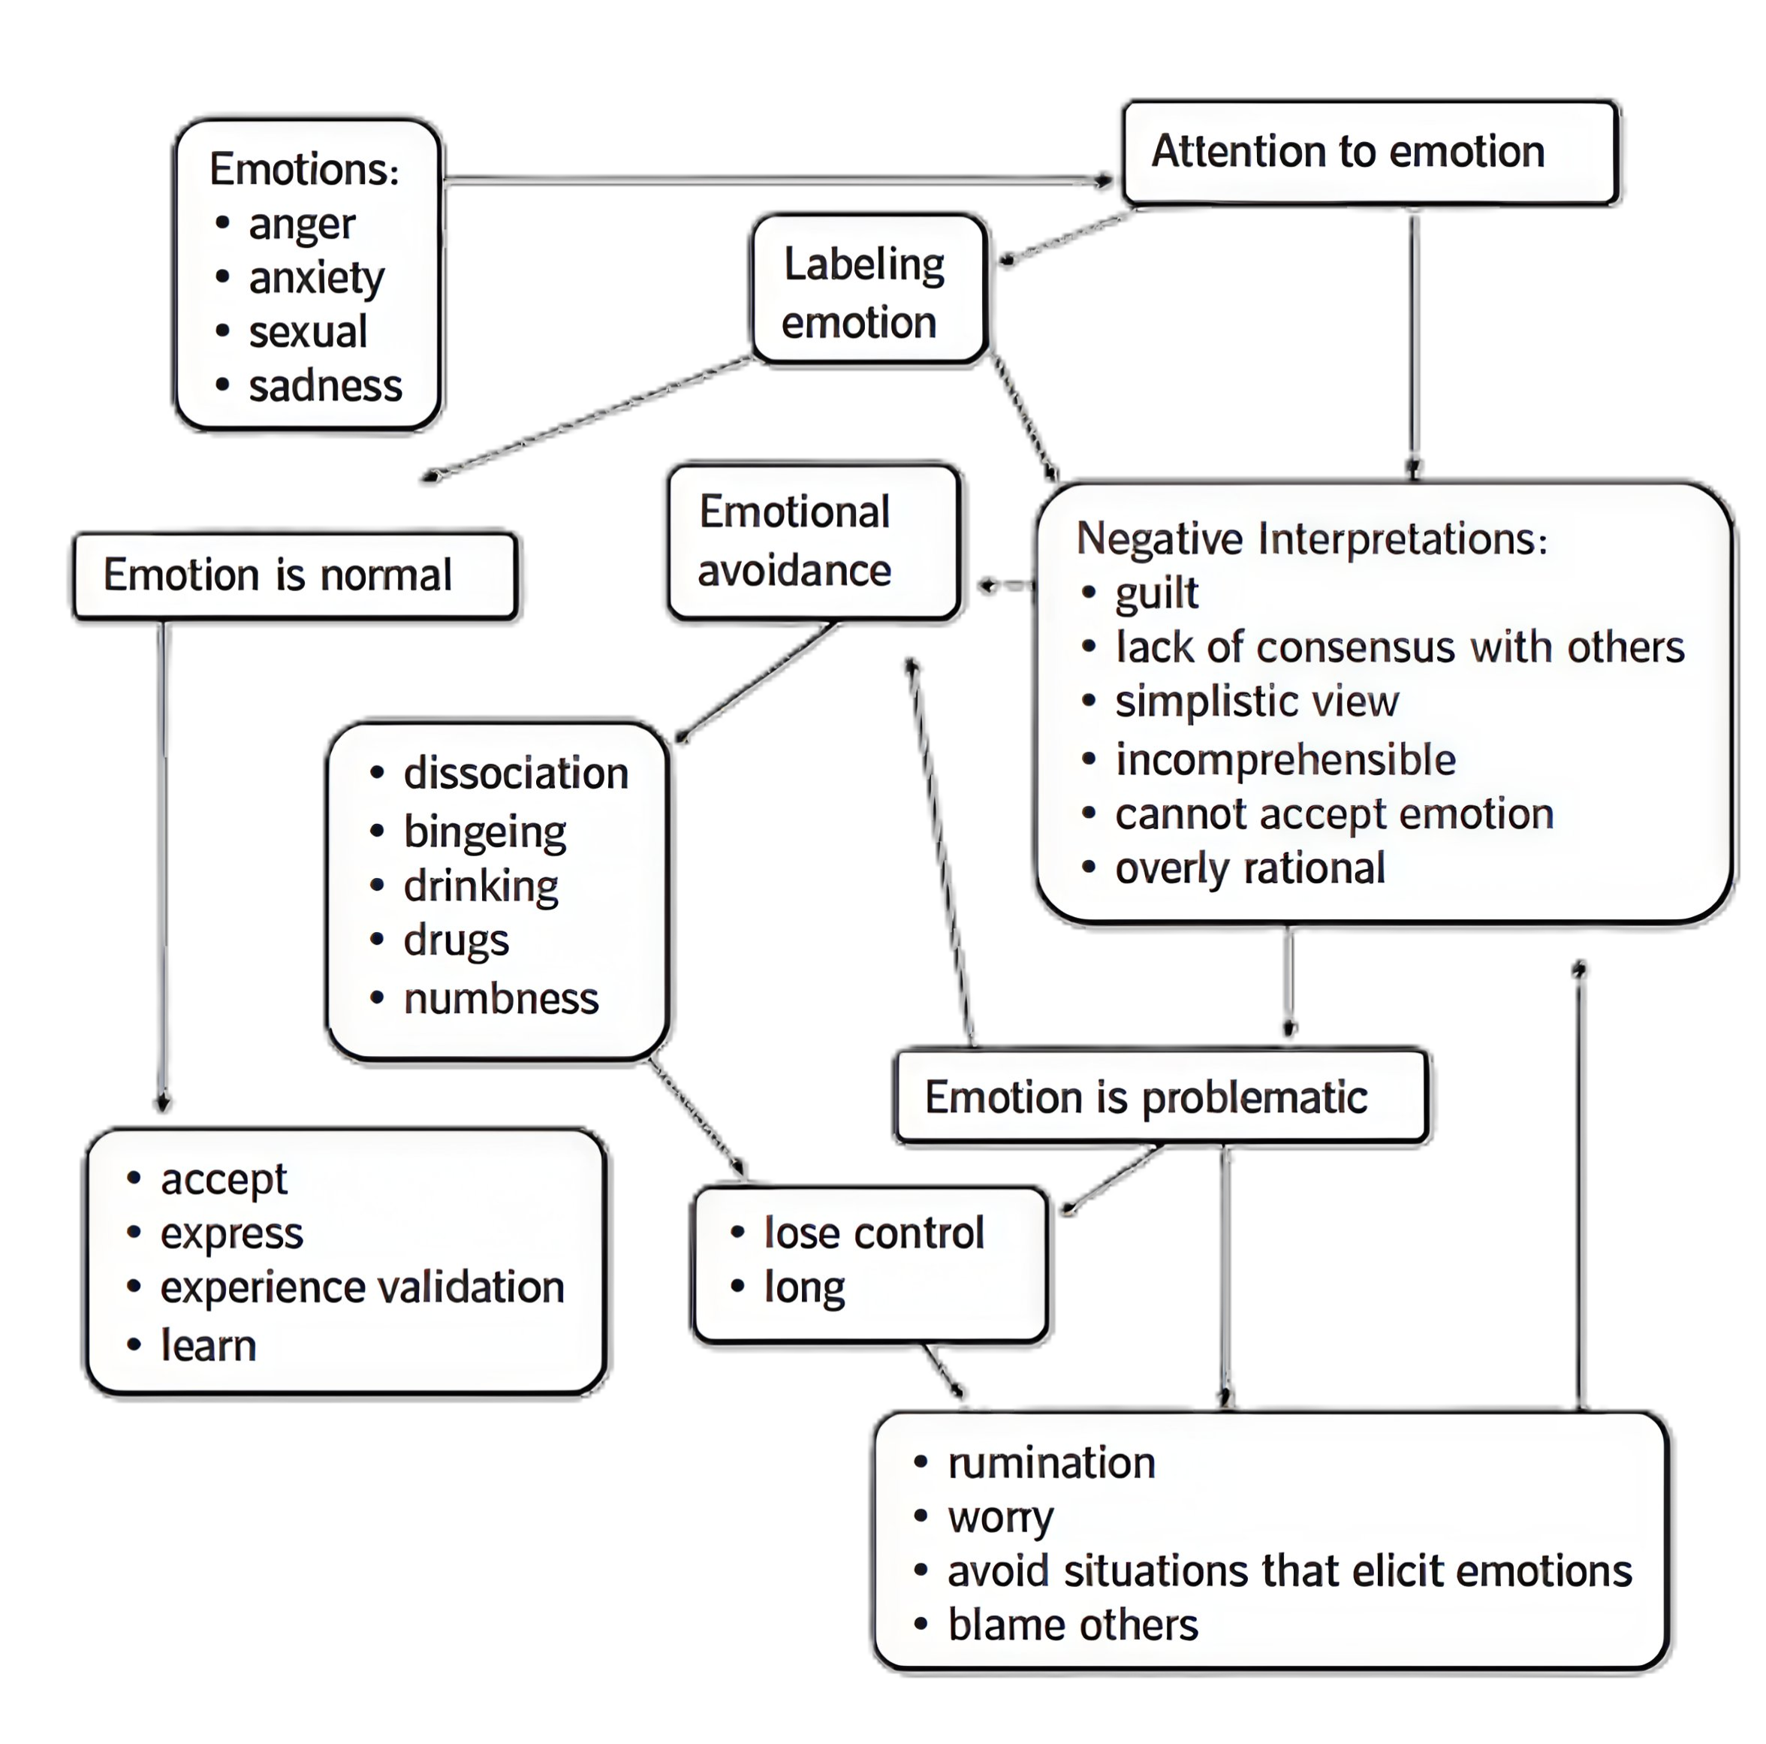




A Model of emotional schemas
Leahy et al. (2011)

Slide 7
Why Regulation is Difficult
High emotional arousal involves physiological activation.
Logical reasoning alone is often insufficient
Cognitive strategies may not directly influence the autonomic nervous system
Daitch (2016)

Slide 8
Hypnotic processes and emotional regulation
Hypnotic process | Potential emotional regulation mechanism
Focused attention / absorption | Shifts attention away from threat cues and increases attentional flexibility
Imagery | Engages emotional and sensory systems and can evoke calming or resourceful states
Psychological distancing | Reduces emotional intensity and creates space for reflection
Physiological calming (relaxation / breathing) | Reduces autonomic arousal and supports parasympathetic regulation
Future pacing / rehearsal | Allows mental rehearsal of adaptive responses in emotionally challenging situations
Ego-strengthening / self-support | Enhances perceived coping ability and self-soothing capacity
Daitch (2007)

Slide 9
Hypnotic processes
Regulation of physiology
breathing
relaxation
Heaviness
Calming imagery (dialling down reactivity, breathing in the light, safe place imagery).
Regulation of attention
focused attention (induction)
mindfulness
imagery
Daitch (2007)

Slide 10
Hypnotic processes
Regulation of perspective
distancing imagery
observing ego
Containment
Metaphor
Positive affect development (e.g., accessing earlier positive emotional states)
Ego strengthening (self concept)
Regulation of behaviour
behavioural rehearsal/future pacing
impulse control
Anchors
Daitch (2007)

Slide 11
The use of suggestion
Suggestions determine which system you are influencing.
Physiology
“Let the out-breath become slightly longer than the in-breath.”
Attention
“Notice the space around the thought.”
Perspective
“You may begin to see this situation differently.”
Behaviour
“When this feeling arises, you pause before responding.”

Slide 12
Expectancy
Expectancy shapes emotional and physiological responses
It is the prediction:
“This will calm me.” “This will help.” “I can cope.” “This will reduce the anxiety.”
De Raedt & Hooley (2016)
Guevarra Kross & Moser (2024)

Slide 13
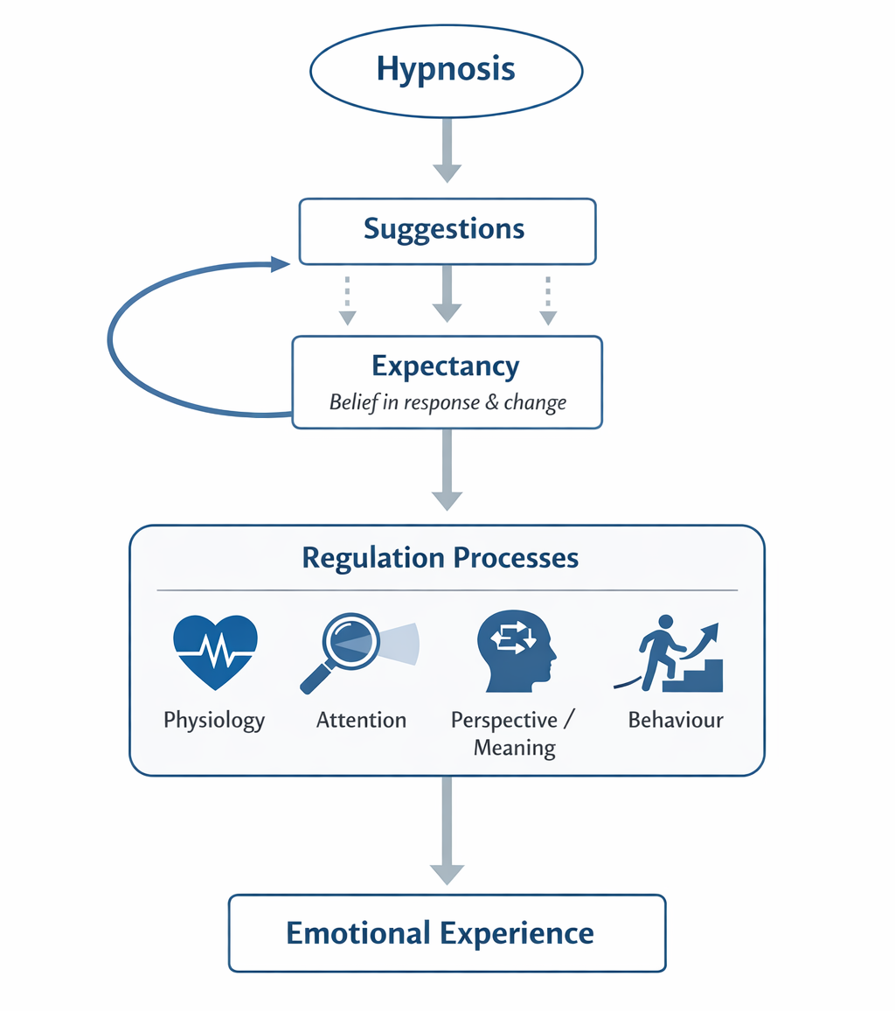
Hypnosis and emotional experience

Slide 14

Clouds in the sky
Notes:
Although this exercise comes from mindfulness and ACT traditions, it involves several of the same psychological processes that we see in hypnosis. It narrows attention, uses imagery, and encourages a gentle dissociation from thoughts so that they can be observed rather than reacted to. These are all processes that hypnosis often uses to help people regulate emotional responses

Slide 15

ANY Questions

Slide 16
References
Berking, M., & Musa, J. (2024). Affect regulation training. In J.J. Gross, & B.Q. Ford, (Eds.) Handbook of emotion regulation. pp 391-398 London: Guilford Press.
Brann, L., Owens, J., & Williamson, A. (Eds.). (2015). The handbook of contemporary clinical hypnosis: Theory and practice. London: John Wiley & Sons.
Daitch, C. (2007). Affect Regulation Tool Box: Practical Effective Hypnotic Interventions Over Reactive Client. London: WW Norton & Company.
Daitch, C. (2016). Affect Regulation. In G. Elkins (ed.) Handbook of medical and psychological hypnosis: Foundations, applications, and professional issues pp 453-461. London: Springer Publishing Company.
De Benedittis, G. (2015). Neural mechanisms of hypnosis and meditation. Journal of Physiology-Paris, 109(4-6), 152-164.
De Raedt, R., & Hooley, J. M. (2016). The role of expectancy and proactive control in stress regulation: A neurocognitive framework for regulation expectation. Clinical psychology review, 45, 45-55.
Guevarra, D. A., Kross, E. T. H. A. N., & Moser, J. S. (2024). Harnessing placebo effects to regulate emotions. In J.J. Gross & B.Q. Ford. Handbook of emotion regulation. pp 112-118 London: Guilford Press.
Leahy, R. L., Tirch, D., & Napolitano, L. A. (2011). Emotion regulation in psychotherapy: A practitioner's guide. London: Guilford press.
Siegel D.J. (2012) The Developing Mind (Second Edition). New York: Guilford.
Tamir, M., & Ford, B. Q. (2012). When feeling bad is expected to be good: emotion regulation and outcome expectancies in social conflicts. Emotion, 12(4), 807.

