Slide 1
PATTERNS OF BURNOUT HOW TO IDENTIFY AND MANAGE FEELINGS OF OVERWHELM AND EXHAUSTION IN THE WORKPLACE
Dr Ann Williamson (BSCAH Accred)
December 2022

Slide 2
Stress is not Burnout
Stress Burnout
Over-engagement Dis-engagement
Emotions are overreactive Emotions are blunted
Produces urgency Produces helplessness and hyperactivity and hopelessness
Loss of energy Loss of motivation, ideals, and hope

Slide 3
Work based risk factors for burn out
Feeling like you have little or no control over your work
Lack of recognition or reward for good work
Unclear or overly demanding job expectations
Doing work that’s monotonous or unchallenging
Working in a chaotic or high-pressure environment
Taking on too many responsibilities, without enough help from others

Slide 4
Personal risk factors for burnout
Working too much, without enough time for socializing or relaxing
Lack of close, supportive relationships
Not getting enough sleep
Perfectionistic tendencies; nothing is ever good enough
Pessimistic view of yourself and the world
The need to be in control; reluctance to delegate to others

Slide 5
WHO Classifies burnout as:
Feelings of energy depletion or exhaustion
Increased mental distance from job,
negativism, cynicism, compassion fatigue
Reduced professional efficacy
Caused by chronic workplace stress,
not successfully managed

Slide 6
Resilience
Pressures exerted from outside balance against inner resistance (resilience)

Slide 7
RESILIENCE
PRIORITISE / DEPRIORITISE

Slide 8
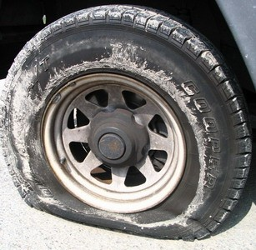
A car tyre needs topping up regularly - otherwise it goes flat!

Slide 9
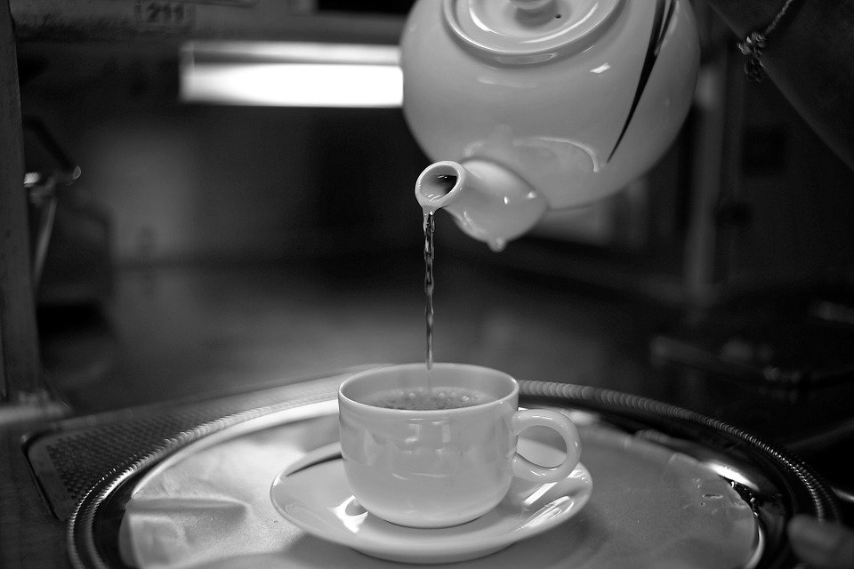
You cannot serve from an empty cup

Slide 10
Timeout
Physical exercise such as jogging, dance etc
Self hypnosis or meditation
Creative outlet such as painting, writing
Brief resets as necessary

Slide 11
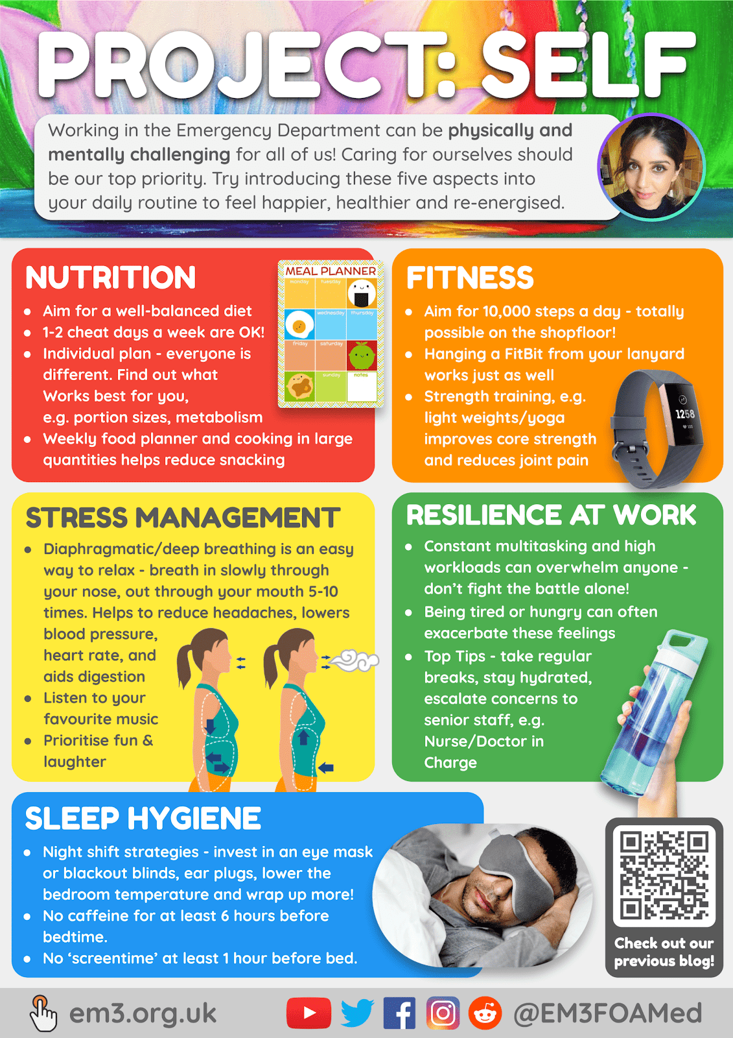
What can help?
Sleep - as much as possible
Eat healthy, regular meals
Keep hydrated - drink a lot of water
Be with positive people
Laugh/smile
Resolve conflicts
Say no – with a smile!
Give to others

Slide 12
Enjoy nature
Take time to relax
Exercise
Body scan
Breathe
Be grateful
Be compassionate to yourself as well as others!

Slide 13
Use Imagery
Visual:-
How you see yourself
How you see others or events
How you see your symptoms
Auditory:-
Self critical internal dialogue
Positive mental rehearsal - Associate with your desired outcome
Goal setting - Associate with the goal
Client generated imagery of a specific problem
What does it look like – what change can you make that would be helpful?

Slide 14
Compassionate Friend Imagery
Close eyes and remember a recent time when you had self criticism
Imagine something to symbolise the critical voice – listen to what it says – notice tonality – notice how it makes you feel
Imagine something to represent the strong, compassionate friend part of yourself - listen to what that part is saying – notice the tonality and how it makes you feel.
Which is working better to encourage you to do better?
Practice until your compassionate friend activates as easily as your self criticism!

